Slide 1
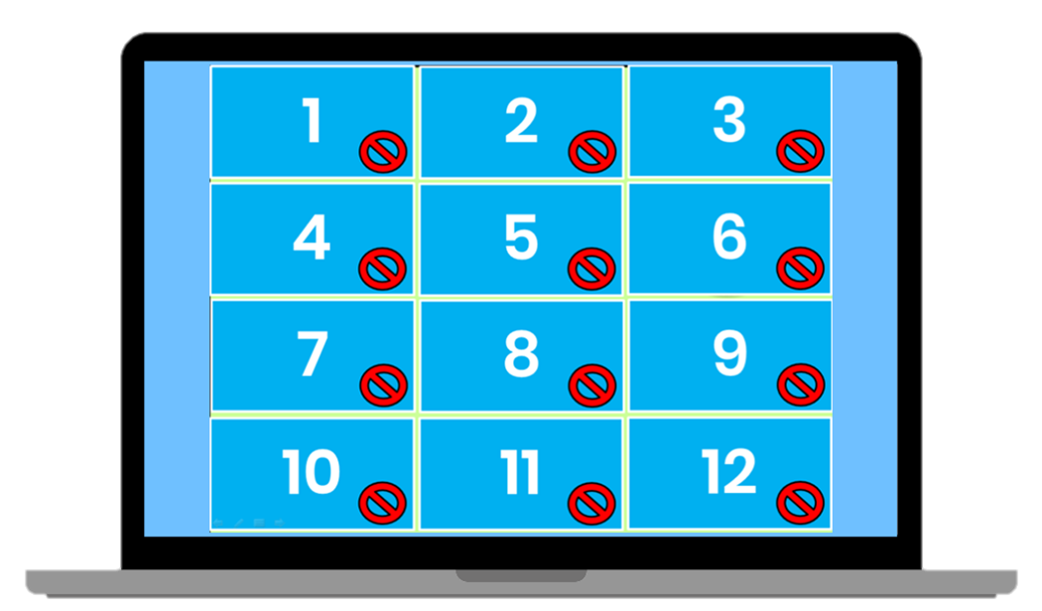
Matching Game Template
How to Edit
To add your own words / pictures to this slide simply place an image or textbox (or both) over one of the squares. Then right click your textbox/ picture and choose ‘Send to the back’. REMEMBER to add two of the same words /pictures.
www.Games4esl.com

Slide 2
1
2
3
4
5
6
7
8
9
10
11
12

